Slide 1

Design patterns

Slide 2

Factory pattern
When
Creating complex object
SOLID (OCP, DIP)
Hiding switch cases
Examples
Calculators
RepositoryRegistry
DBProvider (Abstract Factory) + Tests
Angular
Games
IoC
RedshiftORM -> Dynamic return default Value

Slide 3
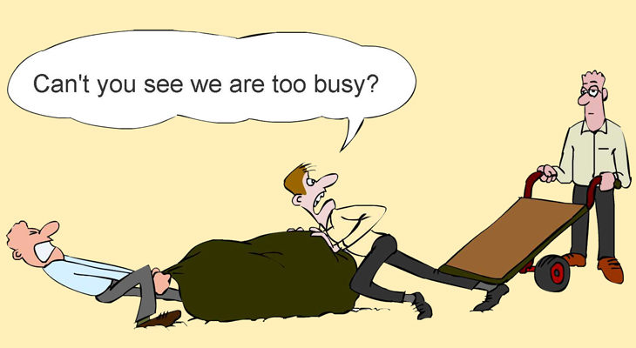
Strategy Pattern
When
To plug in “strategies”
SOLID (SRP, OCP, DIP)
Composition over inheritance
https://www.youtube.com/watch?v=wfMtDGfHWpA
Examples
Calculator
Click Strategies
Events schedule
Medical Events Scheduler
Games

Slide 4
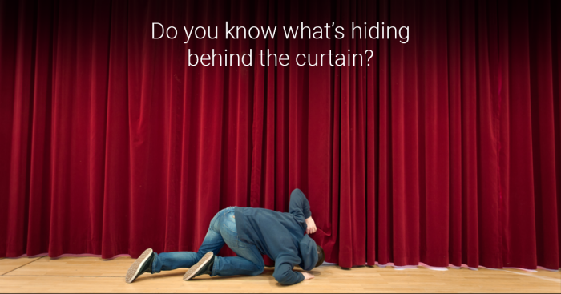
Façade Pattern
When
To hide the complexity and to provide simple interface
SOLID (ISP, SRP, DIP)
To hide a workflow under simple interface
The big three again
Help us to follow SRP with separating
responsibilities into classes
Examples
Click handlers
Payment workflow
API Gateway
Hotel

Slide 5

Mediator Pattern
When
To avoid coupled code (when we have M:N connections)
SOLID (OCP, DIP)
Examples
Filters Layout
Chat room
No more money
With Observables
Waiters to Chefs

Slide 6
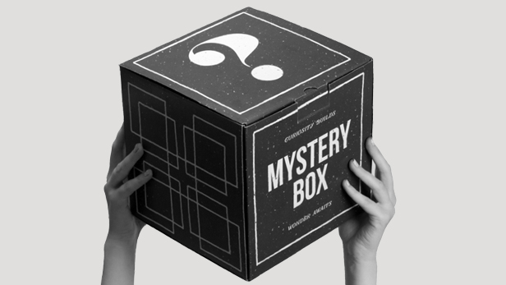
Proxy - Types
When
Virtual Proxies: delaying the creation and initialization of expensive objects until needed, where the objects are created on demand.
Remote Proxies: providing a local representation for an object that is in a different address space. A common example is Java RMI stub objects. The stub object acts as a proxy where invoking methods on the stub would cause the stub to communicate and invoke methods on a remote object (called skeleton) found on a different machine.
Protection Proxies: where a proxy controls access by giving access to some objects while denying access to others.
Smart References: providing a sophisticated access to certain objects such as tracking the number of references to an object and denying access if a certain number is reached, as well as loading an object from database into memory on demand. A smart proxy provides additional layer of security by interposing specific actions when the object is accessed. An example can be to check if the real object is locked before it is accessed to ensure that no other object can change it.
When you use some third party class and you can’t just rewrite it.
When you don’t want to mess business logic with caching logic for example, or lazy loading.
https://stackoverflow.com/questions/18618779/differences-between-proxy-and-decorator-pattern

Slide 7

Proxy - Examples
Examples
HighResolutionImage loading (Virtual)
EntityFramework (Virtual)
Socket (Virtual)
Blocked IP addresses (Protection)
Caching (Virtual)
https://sourcemaking.com/design_patterns/proxy/java/1
Cheque/credit card is a proxy for what is in our bank account

